Slide 1
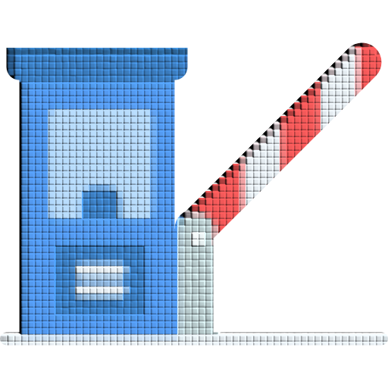
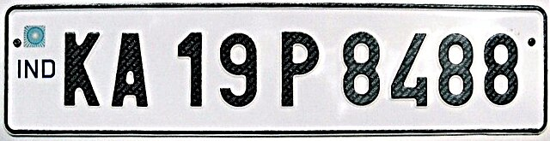
iVIS
intelligent Vehicle Identification System
ES 333
Project Presentation

Slide 2
Table of Contents
01
02
03
04
The Flow
Models Implemented
how it is working?
what all we tried?
Current Implementation
Issues Faced
how is it being done?
problems, uh-oh...

Slide 3
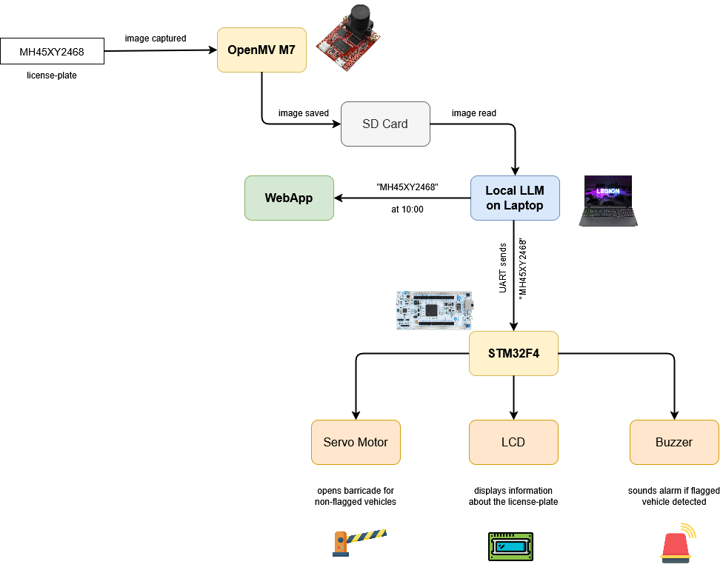
01 – The Flow
image taken from OpenMV
processed via local LLM on laptop
STM32 for actuation and display

Slide 4
02 – Models Implemented
SVMs
MLPs
CNNs
Tesseract

Slide 5
02 – Models Implemented
38% accurate (notebook link)
>80% accuracy, but did not predict all characters correctly
SVMs
CNNs
MLPs
70% accurate

Slide 6
02 – Models Implemented

Slide 7

02 – Models Implemented
developed by Google
free and open-source
OCR specific model for improved accuracy
notebook link

Slide 8
03 – Current Implementation
LM Studio is a toolkit to run LLMs locally
Microsoft’s LLaVa-phiu-3-mini model
local server accessed via python
give prompt and image
returns OCR output

Slide 9

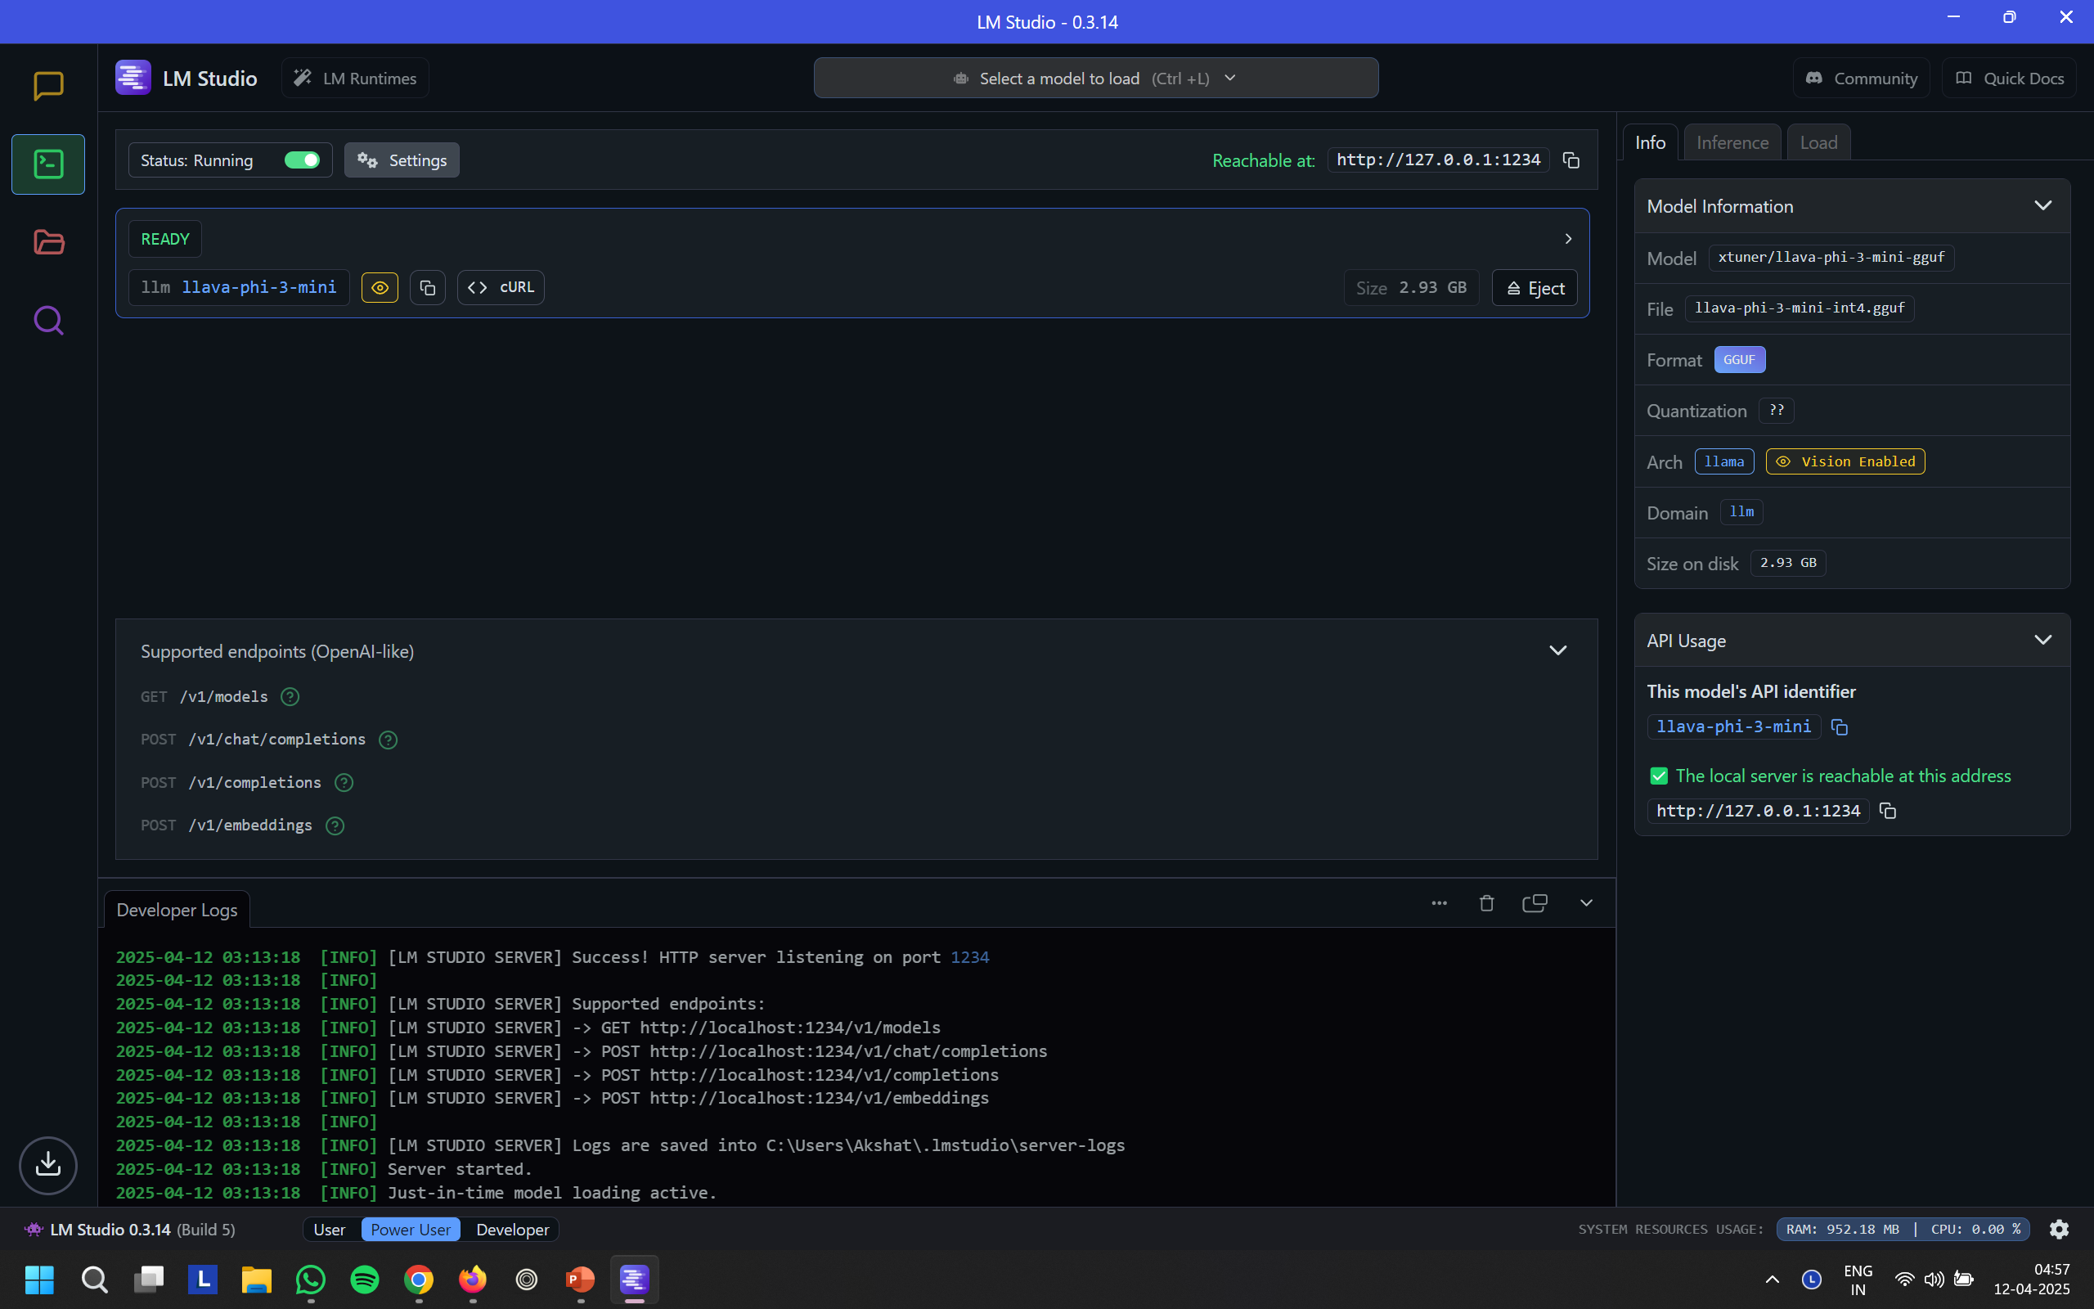
85,320
NEW DRIVERS EVERY YEAR

Slide 10
04 – Issues Faced (OpenMV)
RAM
Storage
128KB RAM
insufficient to run any model, let alone a vision model
it was impossible to process an image in this meagre RAM size
2MB Flash
insufficient to store even efficient models which are still in the MBs
despite quantization, MLP weights were 5.7MB
CNN .tflite model was also 2.17MB
hence, we shifted to performing OCR on the laptop

Slide 11
THANK YOU!

